Slide 1
Bangkit Capstone Project 2021
Skin Cancer Detection
Team Overheat (B21-CAP0005)
Notes:
Hello everyone, today we, from Overheat, would like to show you our Bangkit Capstone project with the theme of Skin Cancer Detection

Slide 2
Table of Contents
01
02
03
04
05
Background
Datasets
Machine Learning
Android
Cloud Computing
Notes:
We are going to show you about our background, Datasets, Machine Learning process, Android app development, backend server, and server deployment on cloud

Slide 3
01
Background
Notes:
First let start with the background

Slide 4
Overview
Skin cancer are one of the most common type of cancers that can affect you. Skin cancer is the abnormal growth of skin cells, it usually develops on the skin that are exposed to the sun or radiation.
Since many Indonesian still needs to work in the open sun, we would like to create an application to detect those skin cancer and handle them before the cancer get worse.
Notes:
Skin cancer are one of the most common type of cancers that can affect you. Skin cancer is the abnormal growth of skin cells, it usually develops on the skin that are exposed to the sun or radiation.
Since many Indonesian still needs to work in the open sun, we would like to create an application that able to detect those skin cancer and suggest a doctor appointment before the cancer get worse.

Slide 5
02
Dataset

Slide 6
Dataset
https://www.kaggle.com/drscarlat/melanoma
We chose melanoma because it is the second most common cancer for men and women age 15-29
Melanoma is also able to spread, making it more dangerous
The Dataset is based on dermoscopic images from HAM10K Dataset
The HAM10K Dataset have an imbalance data of 1,113 Melanoma images and 8,902 Not Melanoma Images
This dataset have augmented the melanoma images to expand those 1,113 images into 8,903 images

Slide 7
03
Machine Learning

Slide 8
Transfer Learning
Inception V3

Slide 9
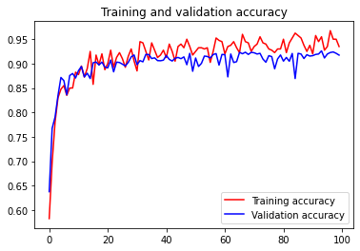
Training and Validation Accuracy
From the graph, it can be seen that during training the accuracy of training set increased to 93-96%, while on validation set, the accuracy increased to 85-90%. Therefore, this model can be said to be quite good based on training and validation
Notes:
Based on the result, the final accuracy for train dataset is 93%, while the final accuracy for the validation dataset is 92%

Slide 10
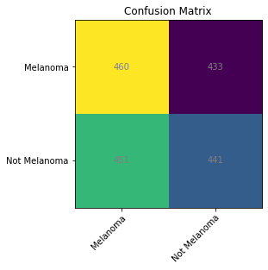
Confusion Matrix
Sadly when predicting from the test set it seems like the model is basically choosing the answer at random and got accuracy, precision, recall, and f1-score around 50%
We have tried and tried again to fix this. Changing model, reshuffling the whole dataset, and trying to create a new model from scratch to no avail.

Slide 11
Why The Model is Bad?
From Training/Testing
Most of the public dataset is in very high quality photos
The model is not big enough
From App
Most of the public dataset are from microscope
We usually use the app for indonesian people but the dataset is from european / american skin
Notes:
Klo high quality diubah jadi 150*150 jadinya kecil banget padahal harus dikirim dari hp (yang harus kecil)
Karena gambarnya besar maka lebih baik klo modelnya juga besar
Sebaiknya data kita berasal dari HP bukan

Slide 12
04
Android

Slide 13
What We Use to Build the Android App
To connect the API with the Android app
Retrofit
Others
Other android jetpack library like navigation, appcompat, fragment, etc that support our app
To save some resources for the app
Room
Carousel
Library for our ‘news’ layout in home page
Dependency injection library for our project
Koin
Coroutines
Concurrency
library so our
app can run asynchronously

Slide 14
Demo Video

Slide 15
05
Cloud Computing
Notes:
Now about the backend server and deployment

Slide 16
BackEnd API
Create REST API using Flasks
Connected with Tensorflow Model
Connected With Cloud SQL (MySQL)
Deployed on Google Compute Engine
Notes:
We begin with creating a rest api using flask.
Flask is a small python web server framework that we can use to create a REST API. after we create the flask app, we connect it with a tensorflow model.
After that, we Connect the app to our cloud sequel instance and finally deploy the app to a compute engine instance

Slide 17
Cloud SQL
MySQL 5.7
Location asia-southeast2 (Jakarta)
PHP My Admin
Add user db_user
Database skin_cancer_app
Notes:
The cloud SeQueL instance, we use are a (1-2) To configure it we also use a local (3) to (4)
And create a (5)

Slide 18
VM Instance
Flask REST API + ML Model are deployed into a Google Cloud Compute Engine
Specifications :
E2-medium (2 vCPUs, 4 GB memory)
Location asia-southeast2 (Jakarta)
Create Firewall Rules to allow android app to access the API
Notes:
We use compute engine to deploy the application. specifically (1) instance located in (2). We also (3)

Slide 19
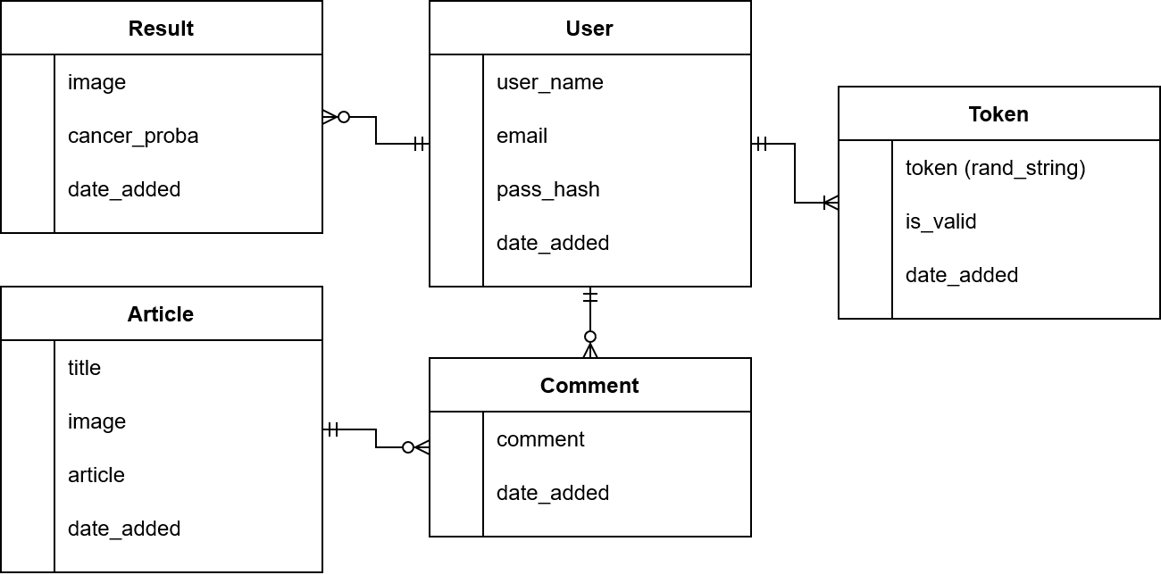
Entity Relationship Diagram
Notes:
so in the entity-relationship diagram (ERD), we have the user which has a relationship with a token which is useful for validating users, one user can have multiple tokens. Users can see about user's results. Users can give comments in the article and the article can have multiple comments.

Slide 20
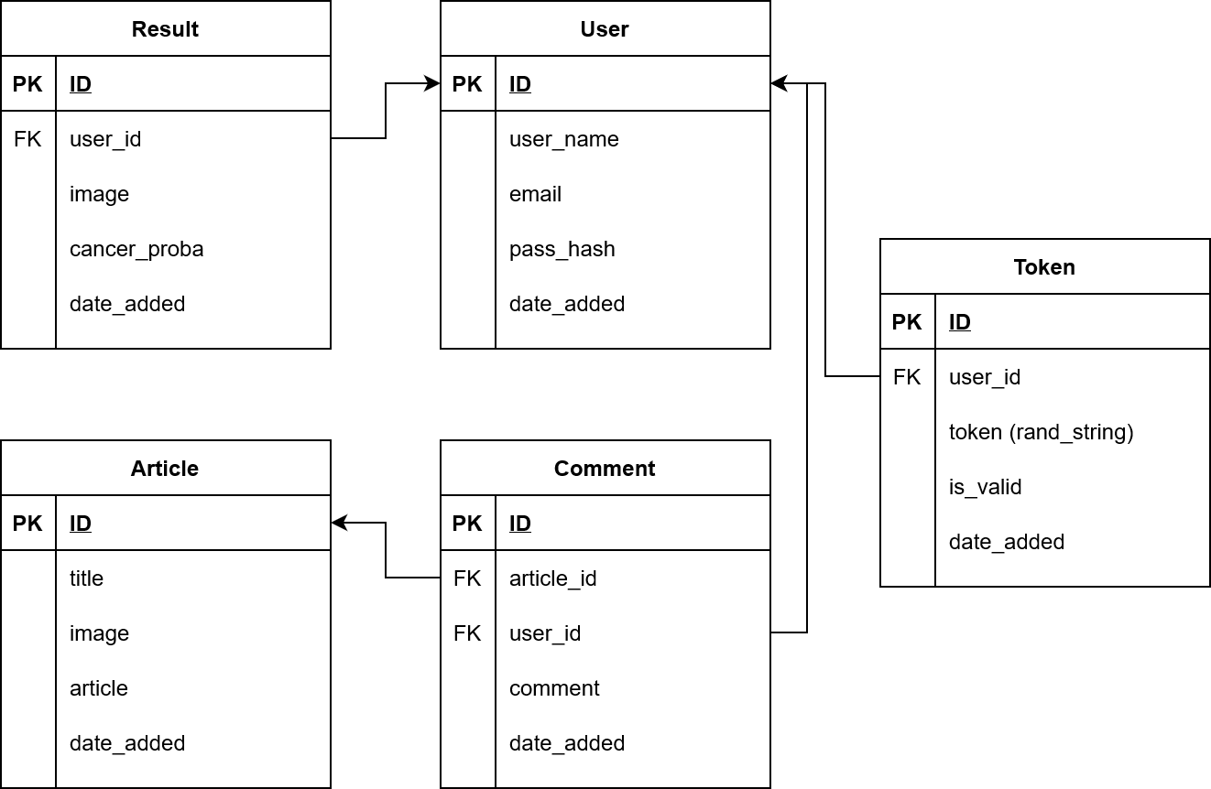
Database Schema
Notes:
Next, we go to the next slide, which's the database schema. Basically, all the entities have the same primary key that is ID, but in token, and result, we have a foreign key named user_id for connected to the user database. For comment, we have 2 foreign keys, article_id, and user_id. user_id for connecting to user and article_id for connecting to the article.

Slide 21
Thanks

